Slide 1
The dynamical response to volcanic eruptions: sensitivity of model results to prescribed aerosol forcing
Matthew Toohey¹
Kirstin Krüger^{1,2}, Claudia Timmreck³,
Hauke Schmidt³
¹ GEOMAR, Helmholtz Centre for Ocean Research Kiel, Germany
² Now at University of Oslo, Norway
³ Max Planck Institute for Meteorology, Germany
SSiRC Workshop, Oct 2013

Slide 2
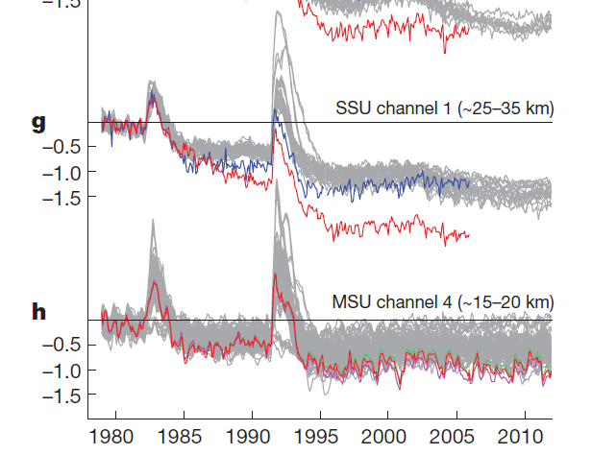
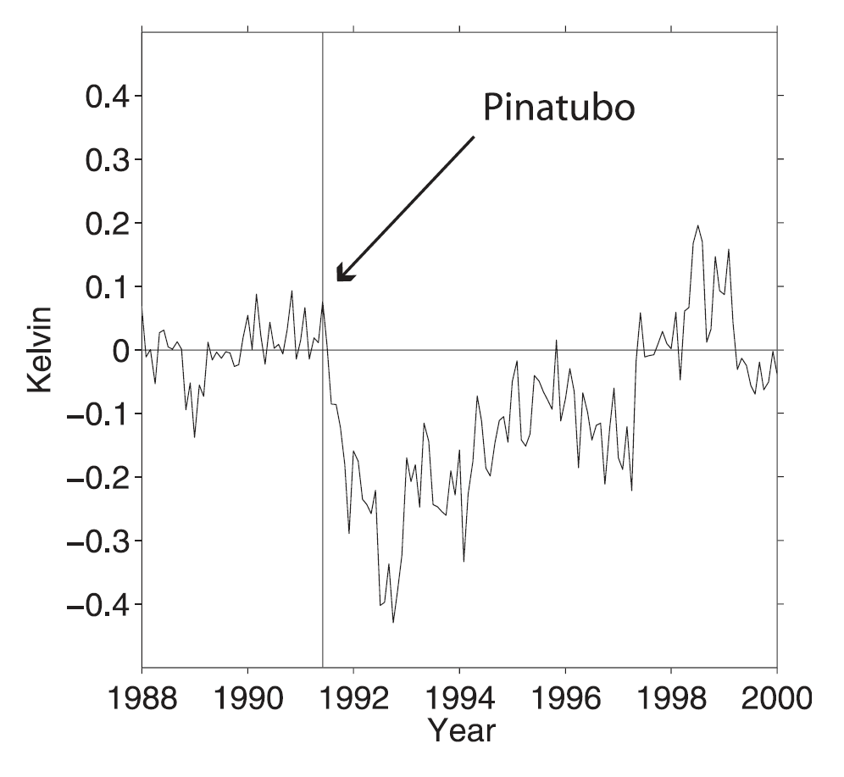
Motivation: if a major eruption occurred tomorrow…
Every seasonal to decadal climate forecast made prior to the eruption would become obsolete.
Thompson et al. (2009)
Thompson et al. (2012)

Slide 3
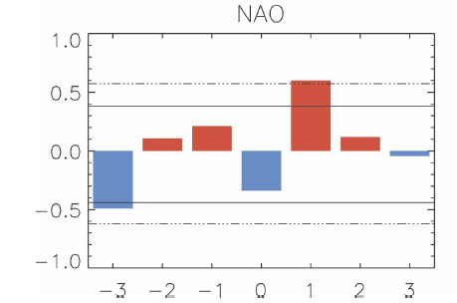
Motivation: if a major eruption occurred tomorrow…
13 eruptions
Christiansen, 2008
Robock and Mao (1992)
Seasonal to decadal climate forecasts might improve in quality!

Slide 4
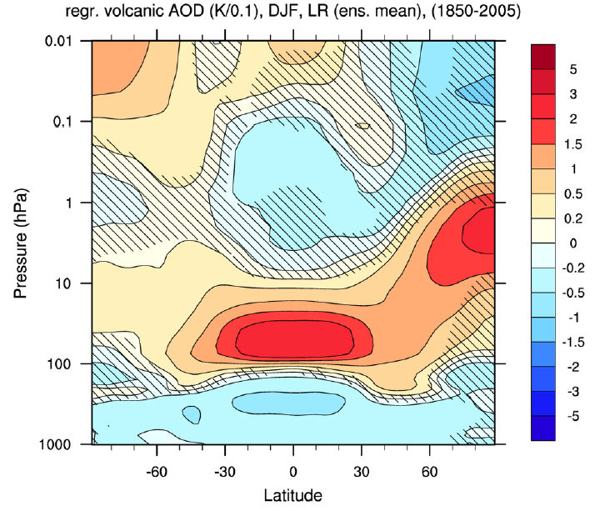
Top-down mechanism
(e.g., Kodera, 1994; Perlwitz and Graf, 1995; Robock 2000; Stenchikov et al., 2002)
Aerosol heating of tropical stratosphere
Enhanced meridional T gradient
Anomalously strong polar winter vortex
Downward propagation of positive NAM signal projects on surface NAO
Schmidt et al., 2013
Direct consequence
Thermal wind balance
Strat-trop
coupling

Slide 5
Top-down mechanism
(e.g., Kodera, 1994; Perlwitz and Graf, 1995; Robock 2000; Stenchikov et al., 2002)
Aerosol heating of tropical stratosphere
Enhanced meridional T gradient
Anomalously strong polar winter vortex
Downward propagation of positive NAM signal projects on surface NAO
Schmidt et al., 2013
Direct consequence
Thermal wind balance
Strat-trop
coupling

Slide 6
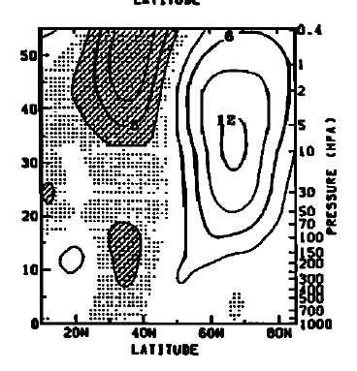
Top-down mechanism
(e.g., Kodera, 1994; Perlwitz and Graf, 1995; Robock 2000; Stenchikov et al., 2002)
Aerosol heating of tropical stratosphere
Enhanced meridional T gradient
Anomalously strong polar winter vortex
Downward propagation of positive NAM signal projects on surface NAO
Direct consequence
Thermal wind balance
Strat-trop
coupling
Dec 1983, 1992: Kodera, 1995

Slide 7
Top-down mechanism
(e.g., Kodera, 1994; Perlwitz and Graf, 1995; Robock 2000; Stenchikov et al., 2002)
Aerosol heating of tropical stratosphere
Enhanced meridional T gradient
Anomalously strong polar winter vortex
Downward propagation of positive NAM signal projects on surface NAO
Direct consequence
Thermal wind balance
Strat-trop
coupling
Baldwin and Dunkerton, 2001

Slide 8
Top-down mechanism
(e.g., Kodera, 1994; Perlwitz and Graf, 1995; Robock 2000; Stenchikov et al., 2002)
Aerosol heating of tropical stratosphere
Enhanced meridional T gradient
Anomalously strong polar winter vortex
Downward propagation of positive NAM signal projects on surface NAO
Direct consequence
Δ O₃
Thermal wind balance
Δ upward wave flux
Anomalous surface T
Strat-trop
coupling

Slide 9
CMIP5: post-volcanic composites
9 eruptions
13 models
72 members
9 eruptions
n=18
Sea level
Pressure
4 eruptions
n=8
9 eruptions
13 models
72 members
50 hPa
Geopotential
height
Driscoll et al. 2012

Slide 10
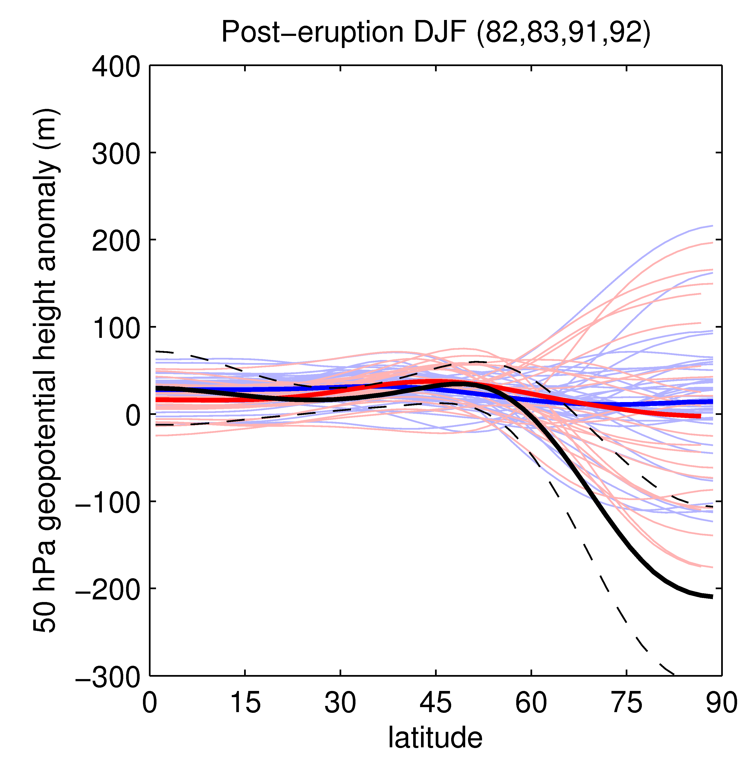
CMIP5: post-volcanic composites
Why don’t CMIP5 models show strong NH winter vortices after volcanic eruptions?
CMIP5
Low-top
High-top
ERA-interim
Charlton-Perez et al., 2013

Slide 11
Post-volcanic dynamical anomalies
Aerosol heating of tropical stratosphere
Enhanced meridional T gradient
Anomalously strong polar winter vortex
Downward propagation of positive NAM signal projects on surface NAO
Direct consequence
Δ O₃
Thermal wind balance
Δ upward wave flux
Anomalous surface T
Strat-trop
coupling

Slide 12
Experiment
Use one CMIP5 model, MPI-ESM, and run ensemble simulations of Pinatubo, with four different volcanic forcing sets.
Focus on first winter after Pinatubo
MPI-ESM: full Earth System model, with atmosphere, ocean, carbon cycle, vegetation components.
Atmospheric component ECHAM6.
“low resolution” (LR, T63/L47), configuration used here (no QBO).

Slide 13
Volcanic aerosol forcing data sets
monthly mean, zonal mean aerosol extinction, single scattering albedo, and asymmetry factor
S98: Stenchikov et al., 1998, used in CMIP historical experiments, based on SAGE II and UARS (CLAES and ISAMS) data, (late 1990s data versions)
CCMI: based on new SAGE II v7 data.
SVC: Strong vortex composite of MAECHAM5-HAM Pinatubo simulations
WVC: Weak vortex composite of MAECHAM5-HAM Pinatubo simulations
Obs-based
Model-based

Slide 14
MPI-ESM Pinatubo forcing experiment
CMIP5 historical simulations
(12x)
S98
CCMI
SVC
WVC

Slide 15
MAECHAM5-HAM AOD @ 500 nm
12 member Pinatubo ensemble

Slide 16
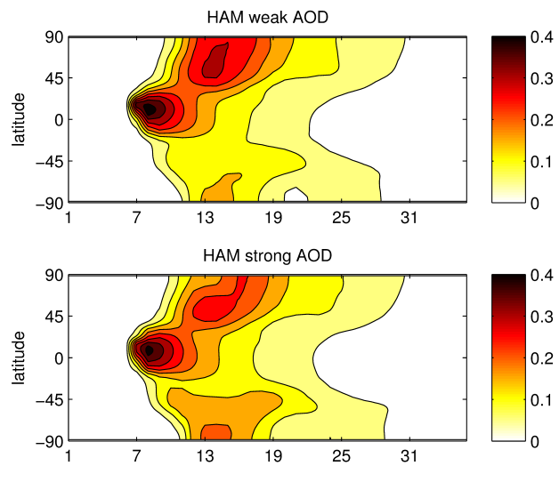
Weak and Strong vortex composite AOD
12 member Pinatubo ensemble
WVC
SVC
n=12

Slide 17
Four Pinatubo aerosol forcing fields
S98
CCMI
SVC
WVC

Slide 18
Results: DJF1 T and u anomalies

Slide 19
Results: DJF1 T and u anomalies

Slide 20
Results: DJF1 T and u anomalies

Slide 21
Direct aerosol heating (Qa)

Slide 22
Dynamical heating (TEM diagnostics)

Slide 23
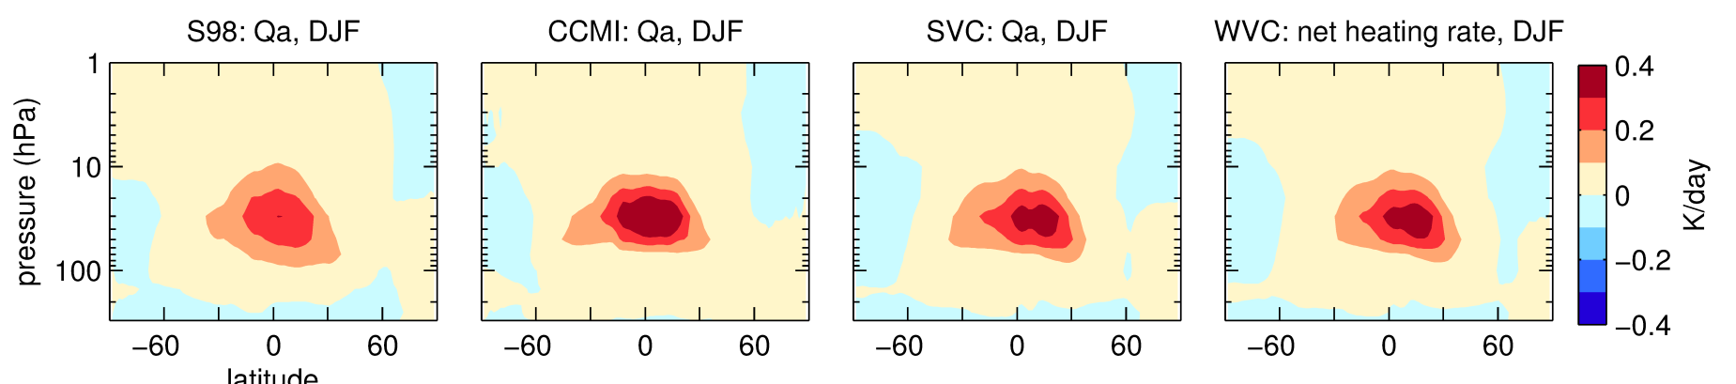
Aerosol + dynamical heating

Slide 24
Zonal wind, EP-flux timeseries

Slide 25
Zonal wind, EP-flux correlation (DJF)
9/12
8/12

Slide 26
Conclusions: mechanism
Changes in vortex strength are an indirect result of tropical aerosol heating, controlled by stratospheric circulation changes.
Dynamics are messy!
All forcing sets lead to an increase in upward EP-flux, which damp vortex strength (cf. Graf et al., 2007)
Differences in DJF wind responses depend on timing of major EP-flux anomalies
Potential mechanism to explain CMIP null results of Driscoll et al. (2012).

Slide 27
Conclusions: forcing sets
Large difference in MPI-ESM response to S98 and CCMI Pinatubo aerosol forcing
S98 forcing produces a modest increase in vortex wind strength (cf., Driscoll et al., 2012).
CCMI forcing leads to weak vortex
Also large difference in MPI-ESM response to SVC and WVC Pinatubo aerosol forcing
Seemingly minor differences in aerosol forcing sets lead to large differences in response
Accurate aerosol fields needed for accurate prediction of polar vortex response.
But, response to SVC and WVC aerosol forcing is consistent with states of construction composites
Still hope for improved prediction!

Slide 28
Extra slides

Slide 29
New mechanism cartoon?
Aerosol heating
(30°S-30°N)
Modified wave propagation conditions
Enhanced EP-flux into stratosphere/ residual circulation
+ T anomaly (30-60°N)
+ T anomaly (60-90°N)
+
-
Vortex strength

Slide 30
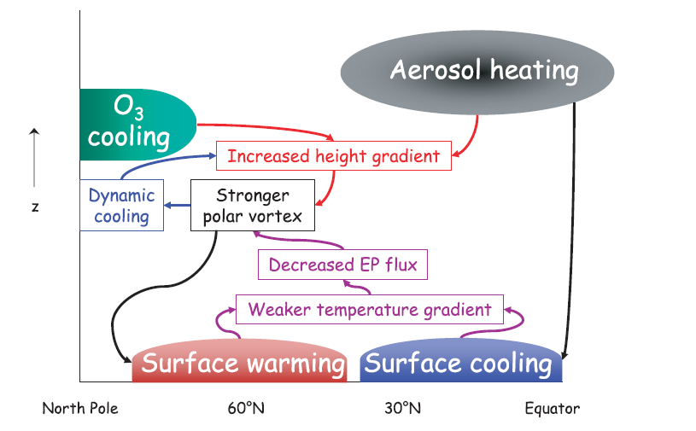
Stratospheric mechanism
Stenchikov et al. (2002)

Slide 31
MAECHAM5-HAM
ECHAM: GCM developed at MPI-M, Hamburg
Middle atmosphere version: 39 vertical levels up to 0.01 hPa (~80 km)
T42 horizontal resolution
Climatological sea surface temperatures, no QBO, no chemistry
HAM: Aerosol microphysical module
Modified for simulation of stratospheric volcanic aerosols
Models aerosol growth, radiative effects, eventual removal
HAM
Aerosol growth
Radiative effects
Inject SO₂ at 24 km
Transport to troposphere, rainout!
SO₂→ H₂SO₄
ECHAM5
Aerosol transport via atmospheric circulation

Slide 32
DJF aerosol net heating rates (Qa)

Slide 35
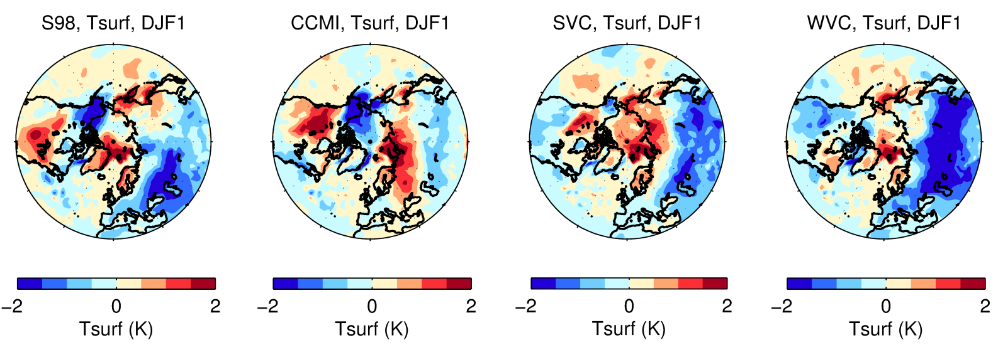
DJF1 surface anomalies

Slide 36
Model results
A number of studies have reported qualified success in the simulation of post-volcanic NH dynamical anomalies (Graf et al., 1993, 1994; Mao and Robock, 1998; Kirchner et al., 1999; Shindell et al., 2001; Rozanov et al., 2002; Stenchikov et al., 2002; Collins, 2004; Shindell et al., 2003, Shindell et al. 2004)
But multi-model studies (e.g. CMIP, CCMVal-2) have not produced a convincing picture...

