Slide 1
Insights into sulfur transport to the stratosphere from past and future aircraft campaigns in the tropics
Marc von Hobe¹, Nicole Spelten¹, Hans Schlager², Frank Arnold^{2,3},
Alexey Ulanovski⁴, Vladimir Yushkov⁴, Fabrizio Ravegnani⁵
¹Forschungszentrum Jülich GmbH, Institut für Energie- und Klimaforschung - Stratosphäre (IEK-7)
²Institut für Physik der Atmosphäre, DLR Oberpfaffenhofen, Germany
³Max-Planck-Institute of Nuclear Physics, Atmospheric Physics Division, Heidelberg, Germany
⁴Central Aerological Observatory, Dolgoprudny, Moskow Region, Russia
⁵Institute of Atmospheric Science and Climate, ISAC-CNR, Rome, Italy

Slide 2
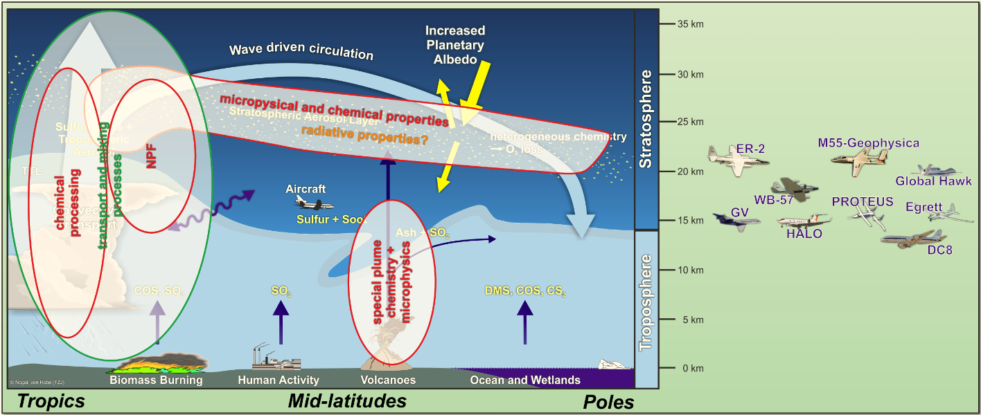
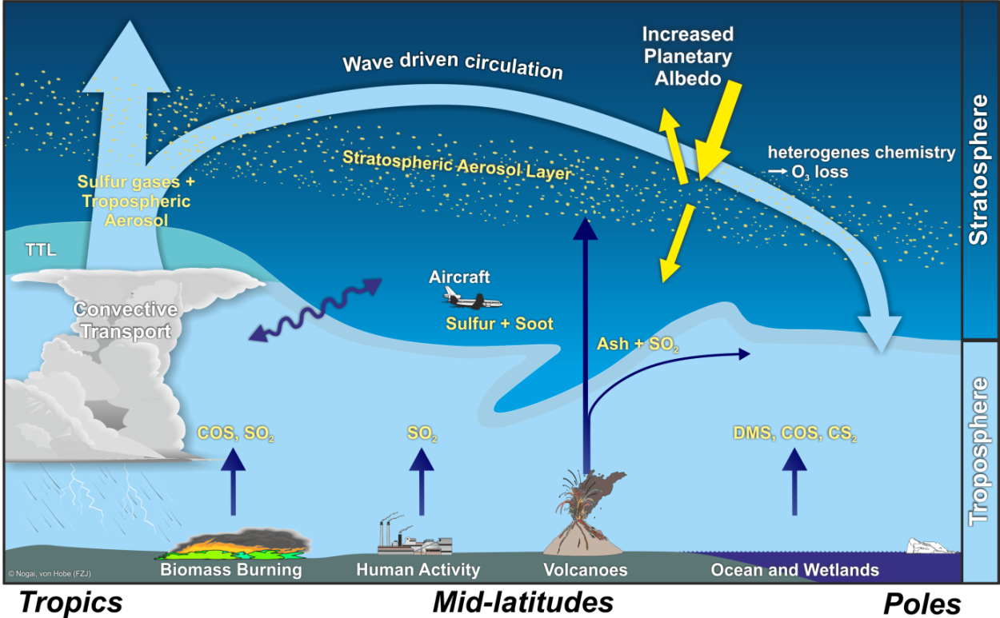
The Junge aerosol is the stratospheric constituent with the most immediate impact on climate in the stratosphere: direct effect on Earth’s energy balance by scattering incoming solar radiation
Aircraft can be used to study relevant transport, chemical and microphysical processes in the stratosphere and upper troposphere

Slide 3
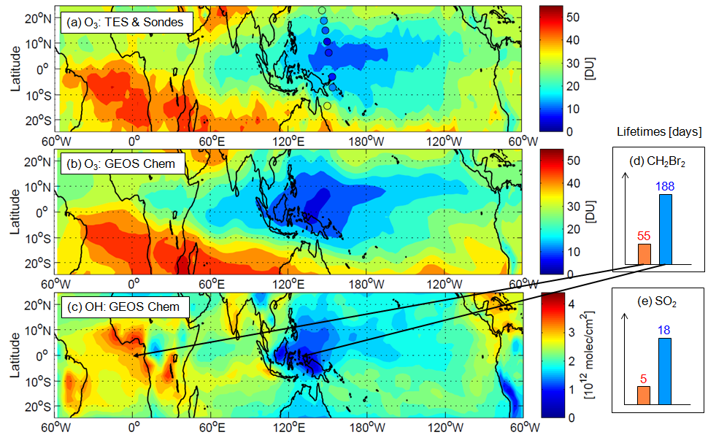
“OH Hole” Theory (Rex et al.)
Tropospheric columns
Are SO₂ lifetimes in the OH Hole really longer?
And if so, does this lead to significantly enhanced SO₂ transport to the stratosphere?

Slide 4
Aircraft observations during the SCOUT-O₃
Darwin, Australia, November/December 2005

Slide 5
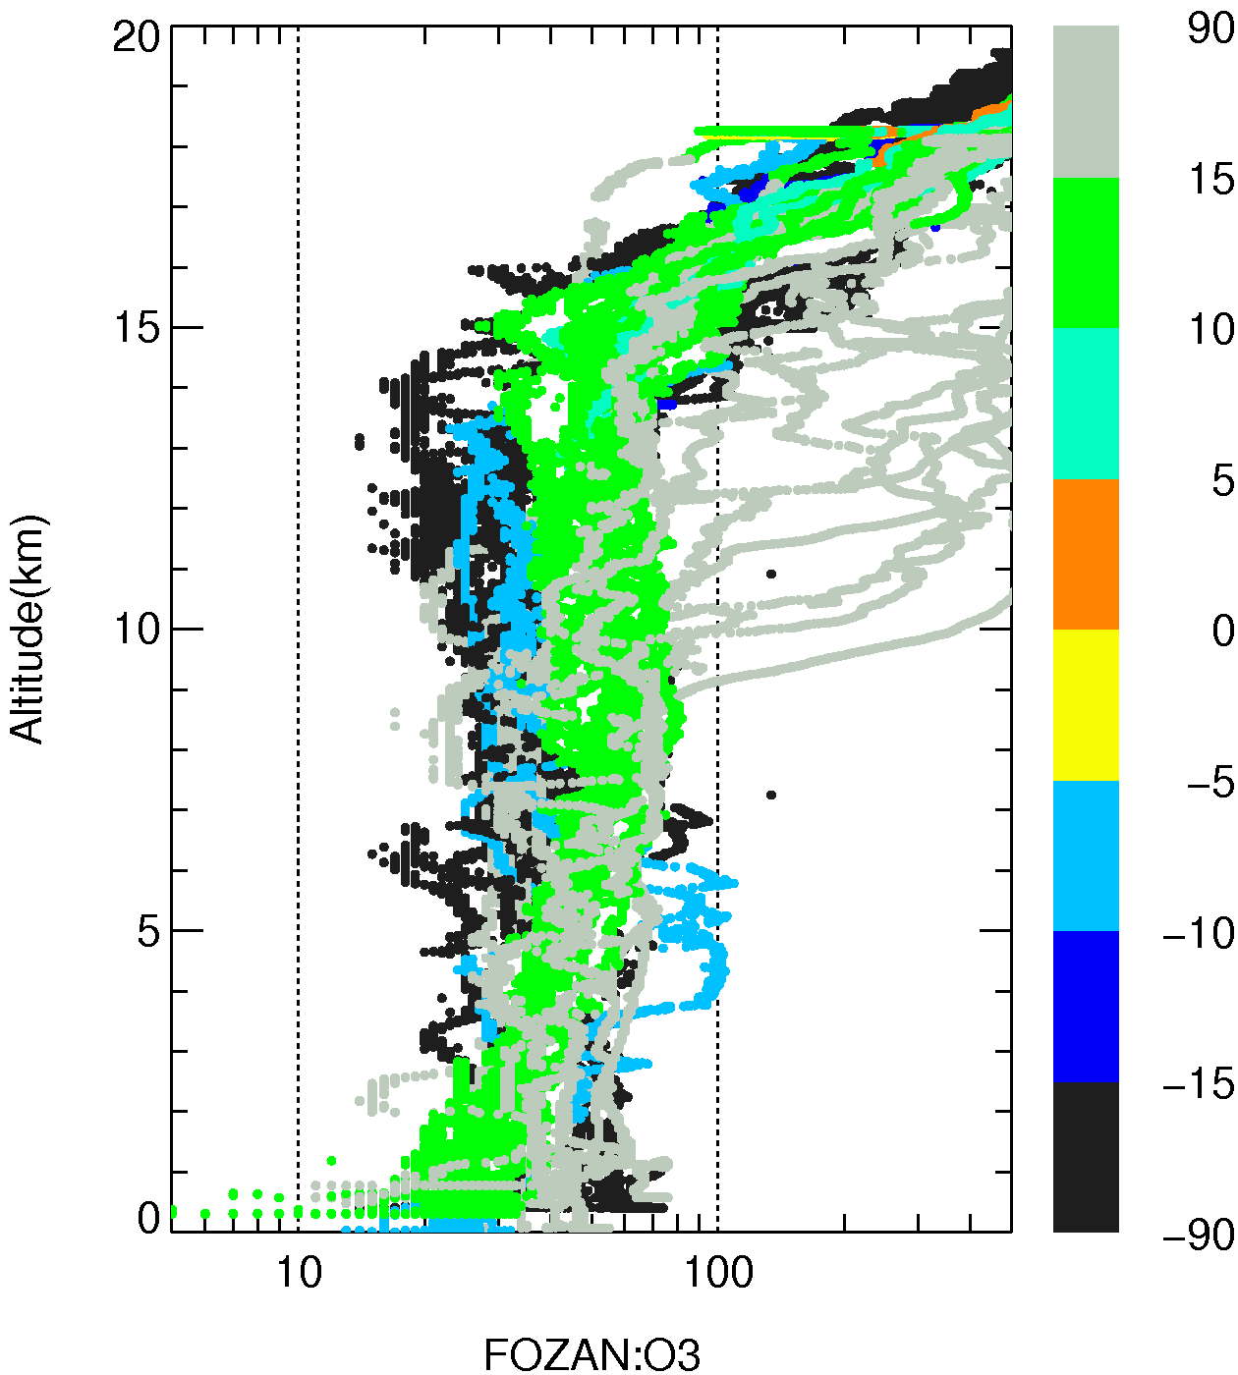
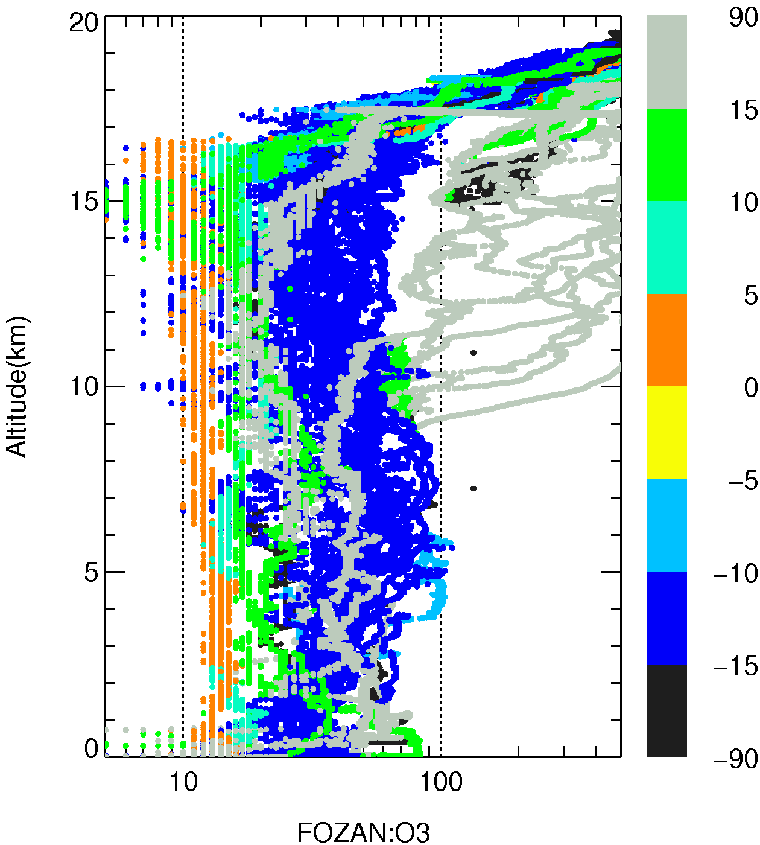
Aircraft observations during the SCOUT-O₃
Recent FOZAN O₃ profiles in the tropics
without SCOUT-O₃ with SCOUT-O₃
✓
OH Hole? O
LT enhancement? O
SO₂ LT enh.? O
Strong SO₂ source O
for stratosphere?
latitude
O₃ < 20 ppb in air masses originating over the Pacific Ocean
Note: tropospheric O₃ < 20 ppb was also observed in some aircraft and ozone sonde observations during ACTIVE (Heyes et al., 2009)

Slide 6
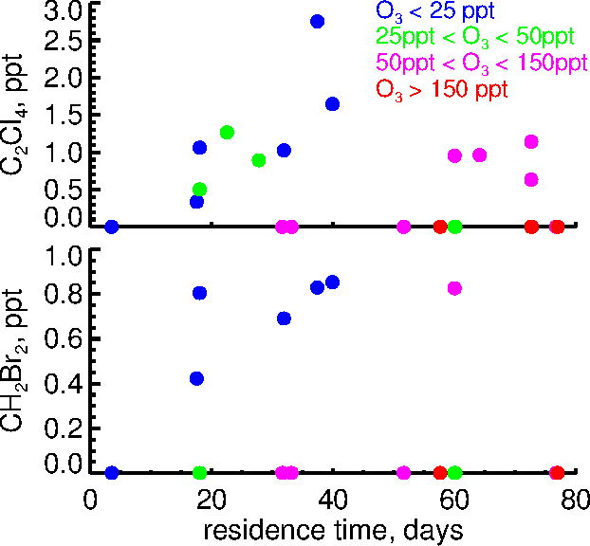
Aircraft observations during the SCOUT-O₃
WAS measurements
during SCOUT-O₃
✓
✓
OH Hole? O
LT enhancement? O
SO₂ LT enh.? O
Strong SO₂ source O
for stratosphere?
since lea-ving the BL
Dibromomethane, CH₂Br₂
strong marine sources in the tropics/subtropics, OH LT (WMO): 123 days, MBL MR: 0.7 - 1.5 ppt
CH₂Br₂ was only detected in low O₃ air, except one observation, where much of the O₃ may have been freshly produced in the TTL and low during tropospheric transit.
Tetrachloroethene, C₂Cl₄
anthropogenic sources (textile industry), OH LT (WMO): 90 days, MBL MR: 1.2 - 3.8 ppt
High mixing ratios also occur in low O₃ air, but the variability is likely to be source driven

Slide 7
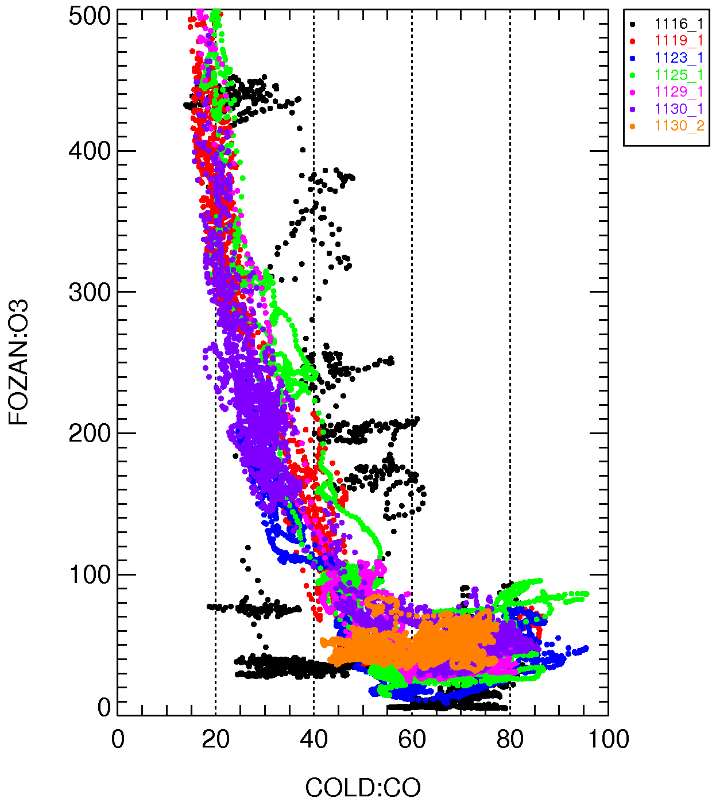
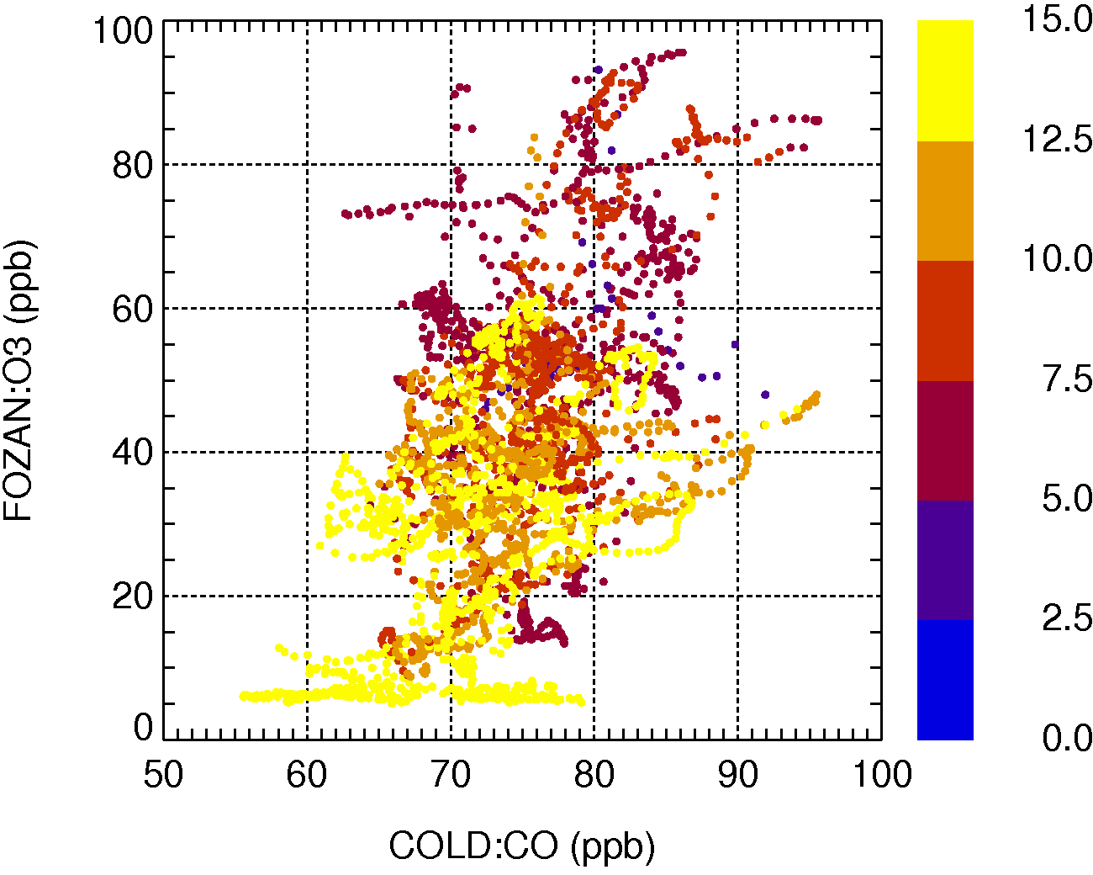
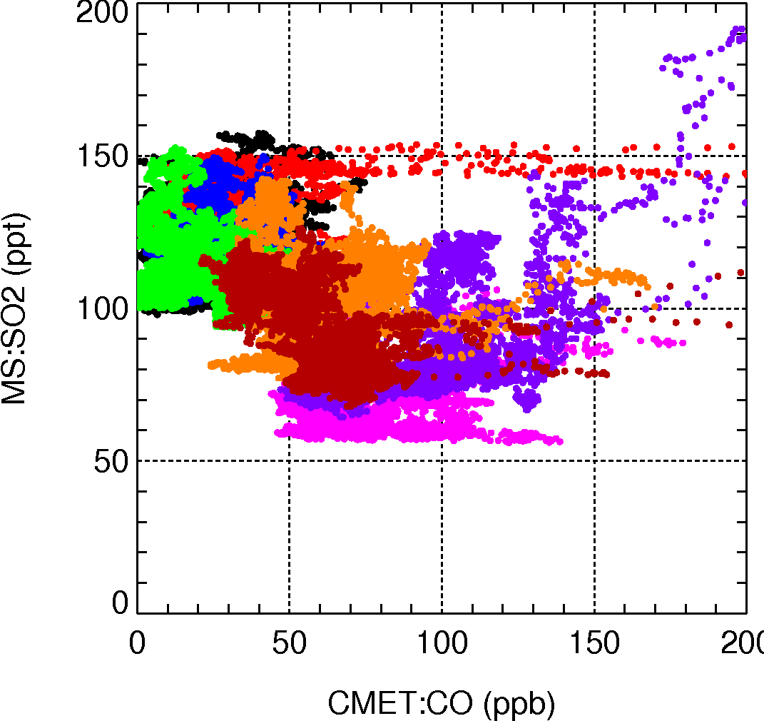
Aircraft observations during the SCOUT-O₃
No SO₂ measurement on M55, no O₃ on Falcon → use CO for correlation analysis
UTLS:
CO and O₃ anticorrelated
Below TTL, O₃ is dominated by tropospheric sources:
→ CO and O₃ are correlated
✓
✓
✓
OH Hole? O
LT enhancement? O
SO₂ LT enh.? O
Strong SO₂ source O
for stratosphere?
Except for distinct pollution events, it seems that in the Western Pacific in winter, SO₂ has a tendency to be higher in cleaner air.

Slide 8
Aircraft observations during the SCOUT-O₃
No SO₂ measurement on M55, no O₃ on Falcon → use CO for correlation analysis
UTLS:
CO and O₃ anticorrelated
Below TTL, O₃ is dominated by tropospheric sources:
→ CO and O₃ are correlated
✓
✓
✓
X
OH Hole? O
LT enhancement? O
SO₂ LT enh.? O
Strong SO₂ source O
for stratosphere?
!!! However, ... !!!
observed SO₂ too low to be dominant strat. sulfur source (transport via OCS @ 500 ppt is at least 3 times as large).
SO₂ in the range expected from the limited marine sources of SO₂ and rapidly oxidized reduced sulfur gases
Except for distinct pollution events, it seems that in the Western Pacific in winter, SO₂ has a tendency to be higher in cleaner air.

Slide 9
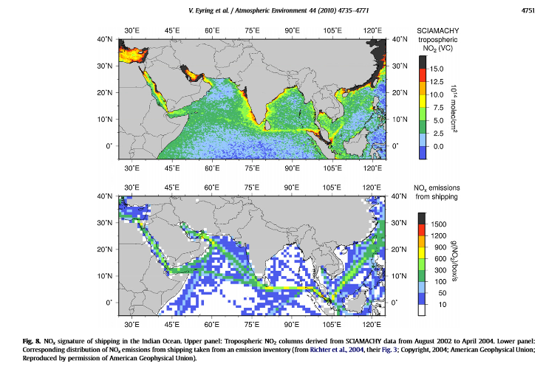
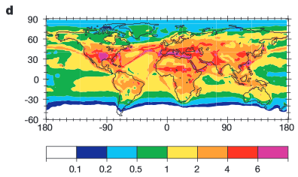
Are “low” SO₂ mixing ratios observed during SCOUT-O₃ climatological?
→ MONITORING Station in W. Pacific as part of StratoCLIM
Possible sulfur sources in OH-Hole air masses
Ship emissions (e.g. Capaldo et al., Nature, 1999) ?
Unlikely to be clean, contain NOx and other pollutants, lead to shorter lifetimes (e.g. Lawrence and Crutzen, Nature, 1999; Eyring et al., Atmos. Environ., 2010)
Surface OH from
Lawrence and Crutzen, Nature, 1999

Slide 10
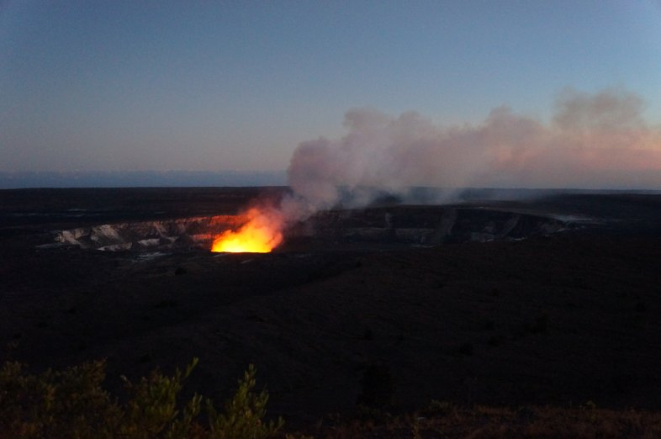
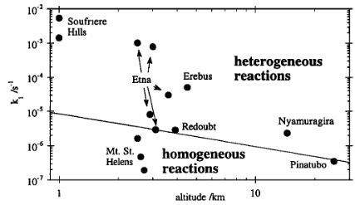
Are “low” SO₂ mixing ratios observed during SCOUT-O₃ climatological?
→ MONITORING Station in W. Pacific as part of StratoCLIM
Possible sulfur sources in OH-Hole air masses
Ship emissions (e.g. Capaldo et al., Nature, 1999) ?
Volcanic outgassing (“ring of fire”)
→ contains H₂O, halogens, aerosols, etc.:
different chemistry!
Oppenheimer et al., GRL, 1998:
SO₂ loss rates in volcanic plumes and emissions
1.7 min
17 min
2.5 h
1 d
11 d
115 d
Photo: Markus Rex
lifetimes

Slide 11
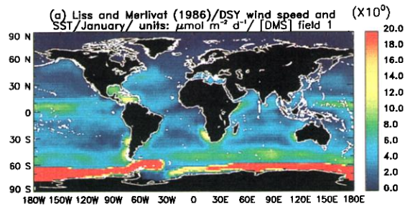
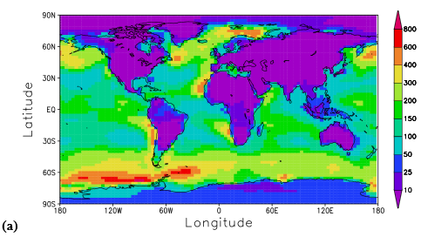
Are “low” SO₂ mixing ratios observed during SCOUT-O₃ climatological?
→ MONITORING Station in W. Pacific as part of StratoCLIM
Possible sulfur sources in OH-Hole air masses
Ship emissions (e.g. Capaldo et al., Nature, 1999) ?
Volcanic outgassing (“ring of fire”)
Marine emissions
Surface DMS flux from Kettle and Andreae, JGR, 2000
Simulated DMS surface mixing ratios
in ppt from Boucher et al., ACP, 2003
~ 1 Tg S from tropical Pacific over 4 months
Consistent with SO₂ observed during SCOUT

Slide 12
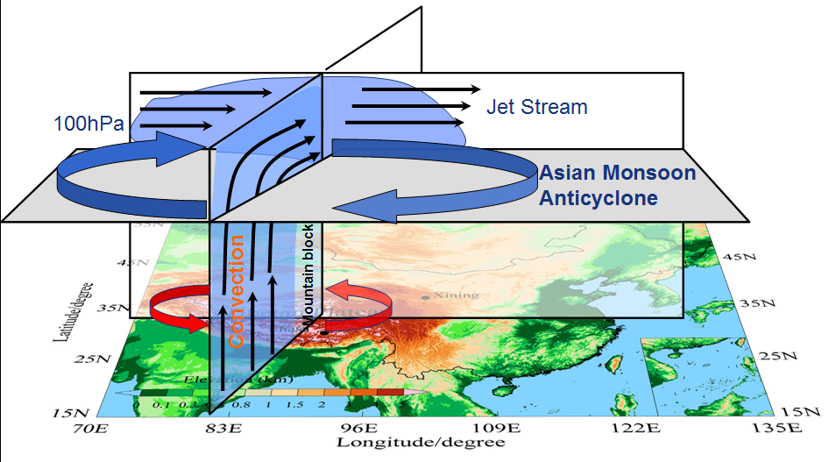
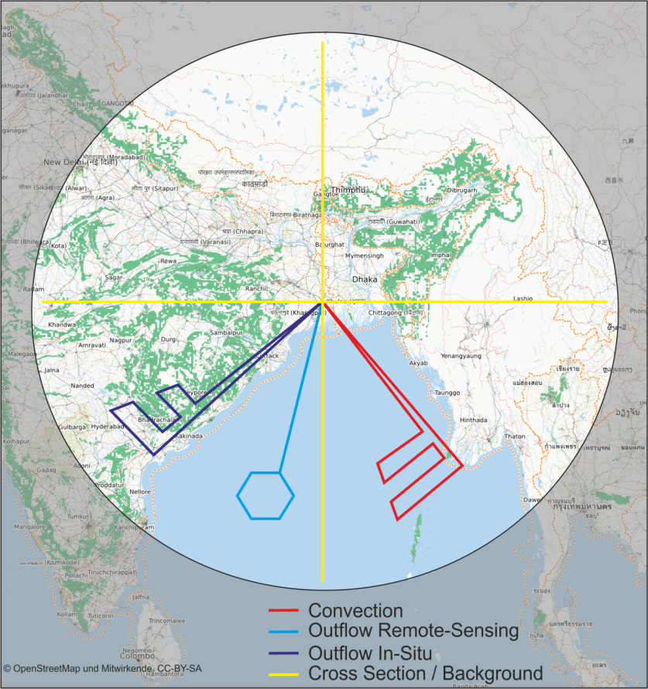
Aircraft observations during StratoCLIM
planned for S. Asia in boreal summer 2015
The Asian Monsoon Anticyclone
is a major transport pathway for air from the troposphere to the stratosphere.
In particular, air from highly polluted source regions can be lifted into the stratosphere.

Slide 13
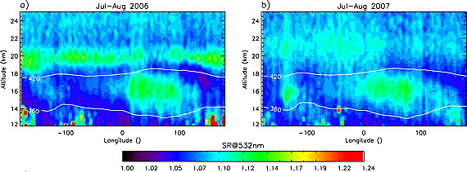
Aircraft observations during StratoCLIM
Vernier et al., GRL, 2011
“Asian Tropopause Aerosol Layer (ATAL)” detected by CALIPSO
Sources: Sulfur pollution, small dust particles, soot, organics
→ Need for in-situ characterisation
Comprehensive analysis of aerosol microphysical properties and chemical composition during StratoCLIM:
COPAS (University/MPI Mainz)
Impactor probe and analysis (Univ./MPI Mainz and TU Darmstadt)
New aerosol mass spectrometers (MPI Mainz)

Slide 14
Aircraft observations during StratoCLIM
(Asian) SO₂ pollution as a source of stratospheric sulfur
Can we observe elevated SO₂ from pollution in the stratosphere?
What are the transport pathways?
How much SO₂ can “survive” convective transport?
Measurements of SO₂ and H₂SO₄ during StratoCLIM by DLR
Also see talks by Hans Schlager and Anke Roiger!

Slide 15
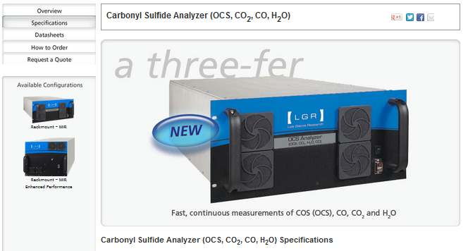
Aircraft observations during StratoCLIM
Carbonyl Sulfide, OCS
Crutzen, GRL, 1976: background Junge layer thought to be sustained by COS
Some estimates of OCS flux to the stratosphere (all in Tg S a⁻¹):
Turco et al., Nature, 1980: 0.15 Tg S/yr
Chin and Davies, JGR, 1995: 0.03 – 0.17 Tg S/yr
Kjellström et al., J. Atm. Chem., 1998: 0.013 Tg S/yr
Barkley et al., GRL, 2008: 0.034 – 0.066 Tg S/yr
Brühl et al., ACP, 2012: 0.15 Tg S/yr
Notholt et al., Science, 2003: larger than expected mixing ratios in the TTL, probably related to biomass burning
High resolution in-situ measurements of OCS and biomass burning tracers during StratoCLIM to study source and conversion processes
Prototype operational on FZJ Met Tower
Airborne instrument under construction
Sensitivity
Goal: HCN at 30 ppt
 | OCS | CO₂ | CO | H2O
Prototype | 10 ppt | 0.3 ppm | 1.5 ppb | 4 ppm
AMICA | 5 ppt | 0.3 ppm | 1.0 ppb | 4 ppm

Slide 16
Conclusions
Observations during SCOUT-O₃ show that transport of reduced sulfur compounds through the “OH Hole” is unlikely to represent a major source of stratospheric sulfur
Measurements planned for the StratoCLIM Geophyisca campaign from South Asia in 2015 will
help to characterize “ATAL” and understand its sources
help to quantify the contribution of anthropogenic emissions in Asia to the stratospheric sulfur budget
help to better constrain OCS fluxes into the TTL and further to the stratosphere

